Slide 1
Web Development SEO & SMO Services

Slide 2
Website Design & Development
Samyak Online in New Delhi was conceptualized in 2000 to provide the industry-best website design and development services at the lowest possible price. After the journey of almost two decades, it has become the leading award-winning website design and development company in India.
Committed to Quality Website Development
Each client has his unique requirement for website development and designing. We understand the requirements and deliver high quality websites at very affordable price.
“As being the prominent website design services company in India, we offer the turnkey customized web designing services with wider scope leveraging your benefits of choosing the best web designing agency.”

Slide 3
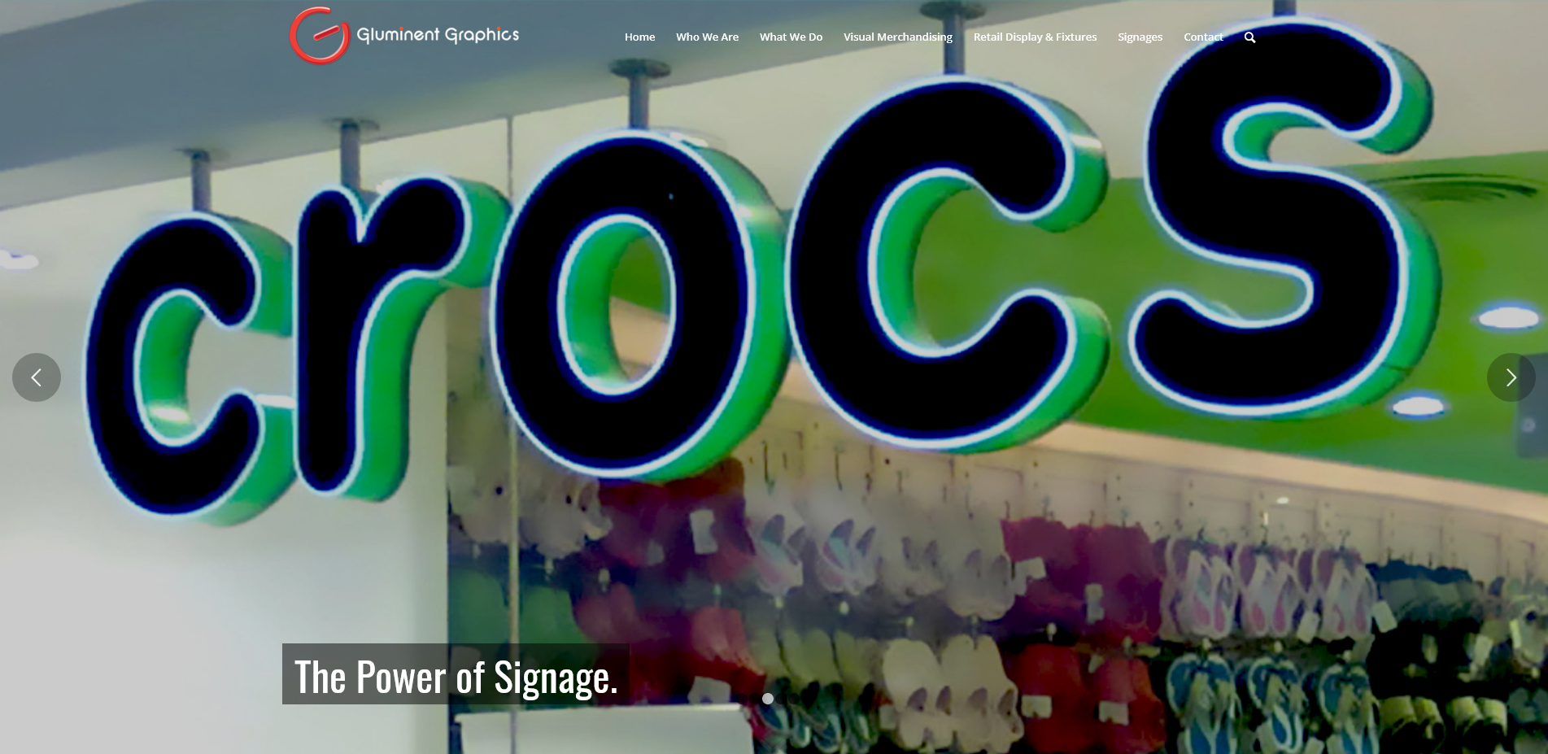
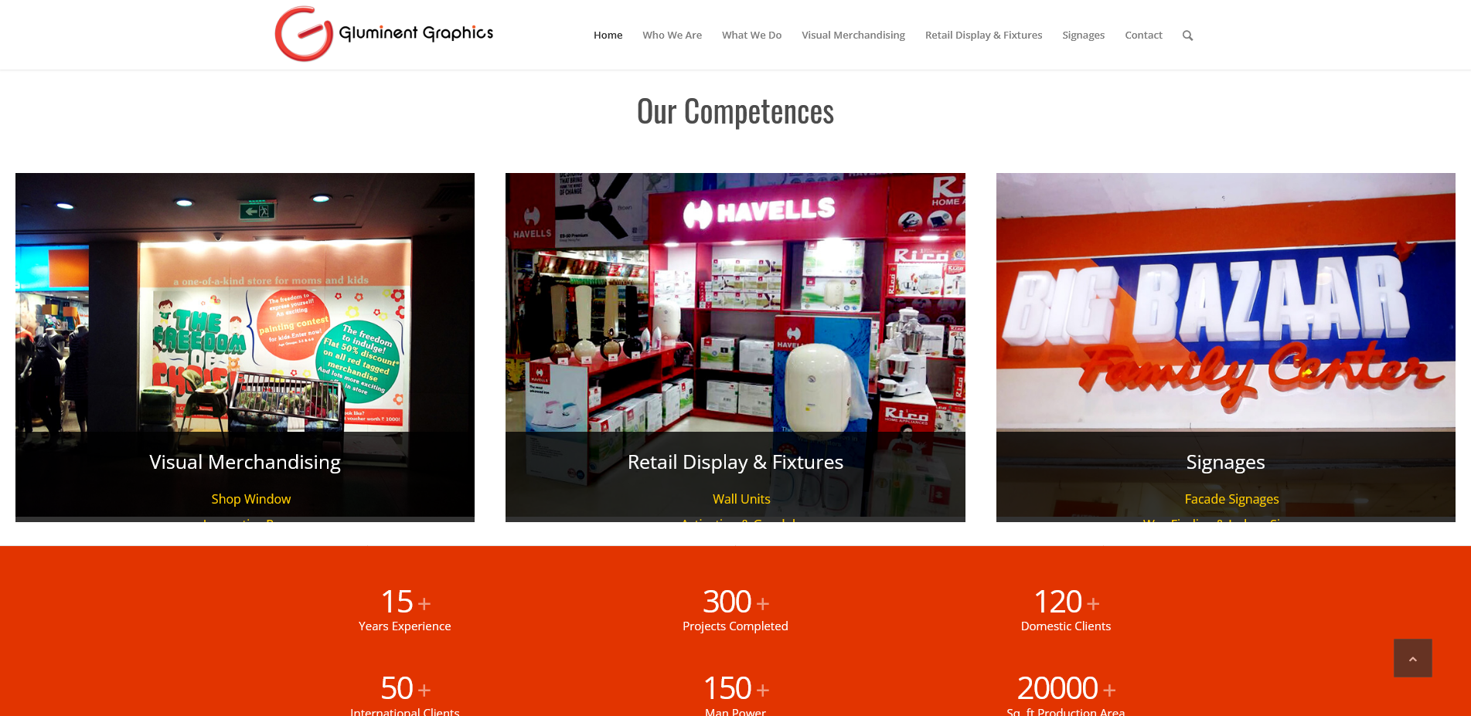
Website Design & Development Portfolio
https://www.gluminentgraphics.in/

Slide 4
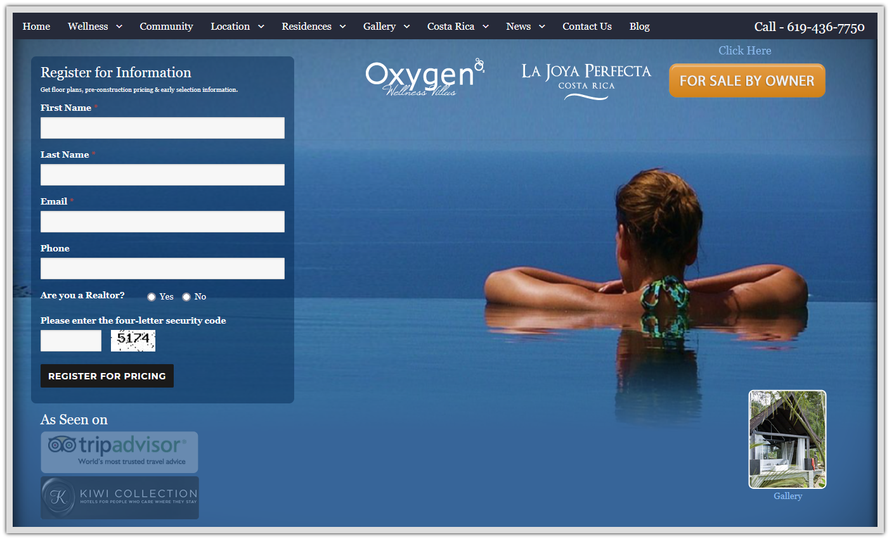
Website Design & Development Portfolio
https://www.costaricawellness.com/

Slide 5
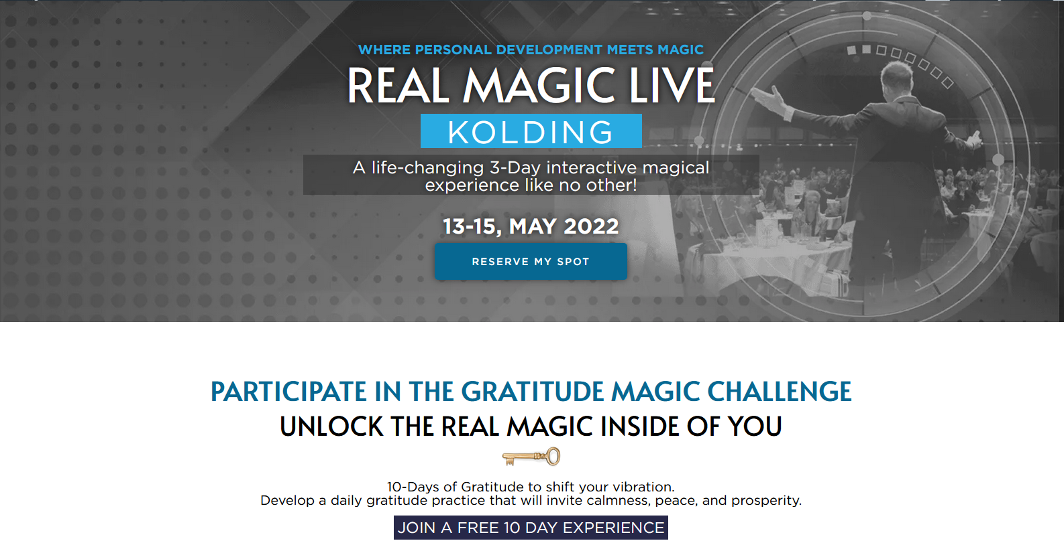
Website Design & Development Portfolio
https://www.andershansen.com/

Slide 6
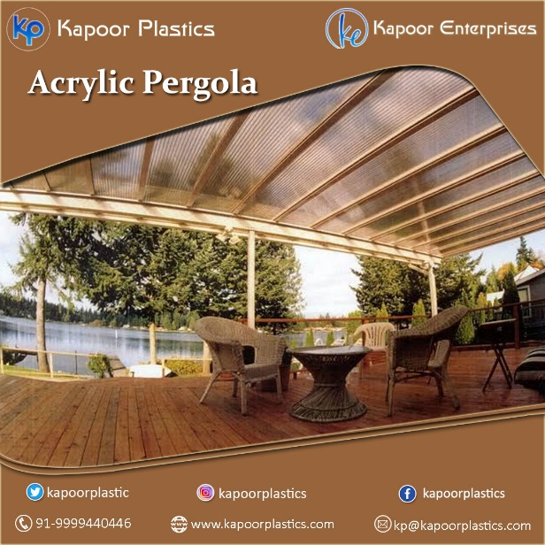
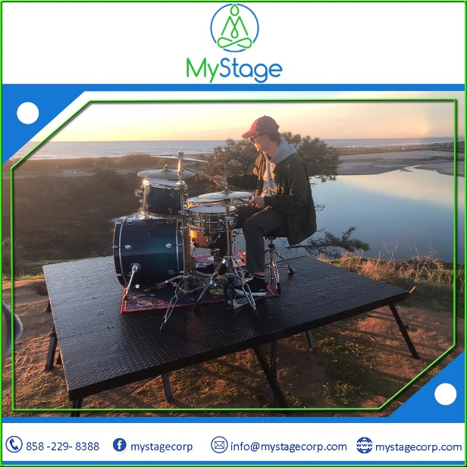
Social Media Optimzation

Slide 7
Brochure Designing

Slide 8
Standee Desinging

Slide 9
SEO Services
Samyak Online is a leading SEO Company based in India that offers quality Search Engine Optimization and SEO Services. Our SEO Professionals do every effort by using white hat SEO techniques to ensure top search engine ranking on Google, Yahoo and Bing. Our SEO Processes are as per Google SEO guidelines.
SEO Process
SEO Requirements
SEO Strategy
SEO Implementation
SEO Campaign Monitoring
Monthly SEO Reports
More Traffic
More Leads
More Business Growth
More Trust and Authority

Slide 10
On Page SEO
Meta Tags Optimization (Titles, Meta Descriptions & Meta Keywords Optimization)
H Tags Optimization
HTML Code Cleanup & Optimization
Site Content Optimization
Anchor Text Optimization
Internal Linking Structure and Site Navigation Optimization
SEO Friendly URLs
Creation of side & Footer links if needed
Optimization of javascript, flash which hinders robots crawling
Image Alt Tags Optimization
Error Page Configuration
XML Sitemap Creation
Static Sitemap Creation & Optimization
Robots.txt Creation

Slide 11
Off Page SEO
Off Page SEO
Articles Submission Services
Social Bookmarking Services
Affiliate Marketing Services
Forums Participation Services
Blog Posting
PR Distribution Services
Ezine Promotion Services
Directory Submission Services
Podcast Promotion Services
RSS Marketing Services

Slide 12
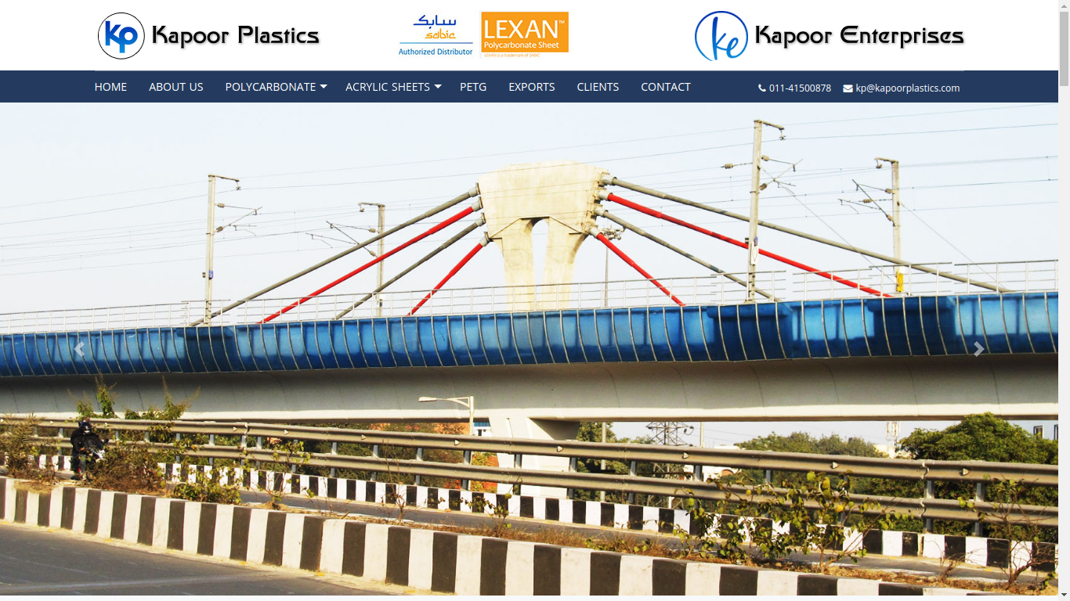
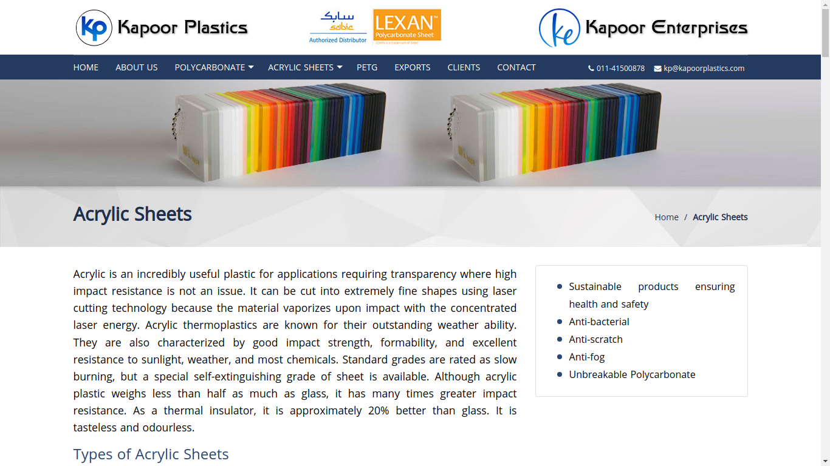
SEO Portfolio
https://www.kapoorplastics.com/
https://www.kapoorplastics.com/acrylic-sheet.php

Slide 13
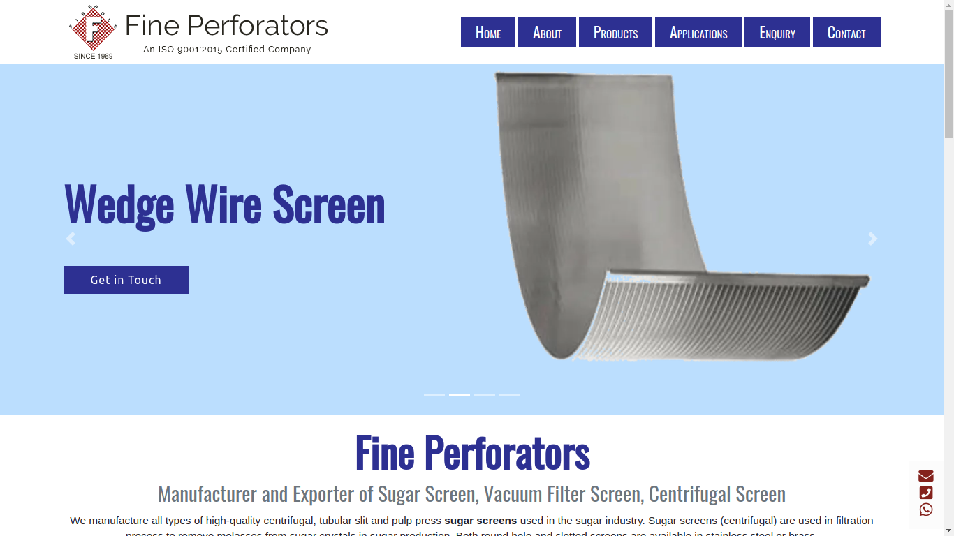
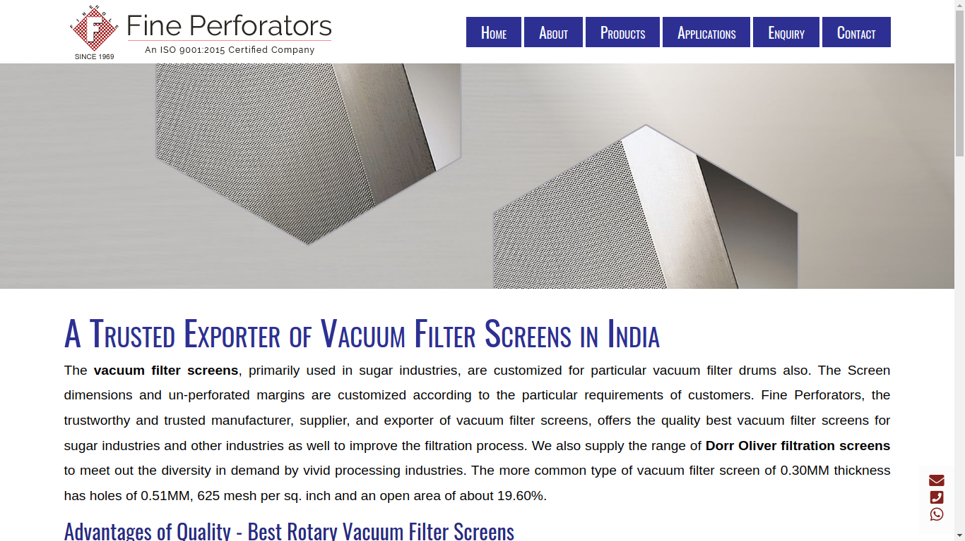
SEO Portfolio
https://www.finehole.com/
https://www.finehole.com/vacuum-filter-screen-manufacturer-exporter-india.php

Slide 14
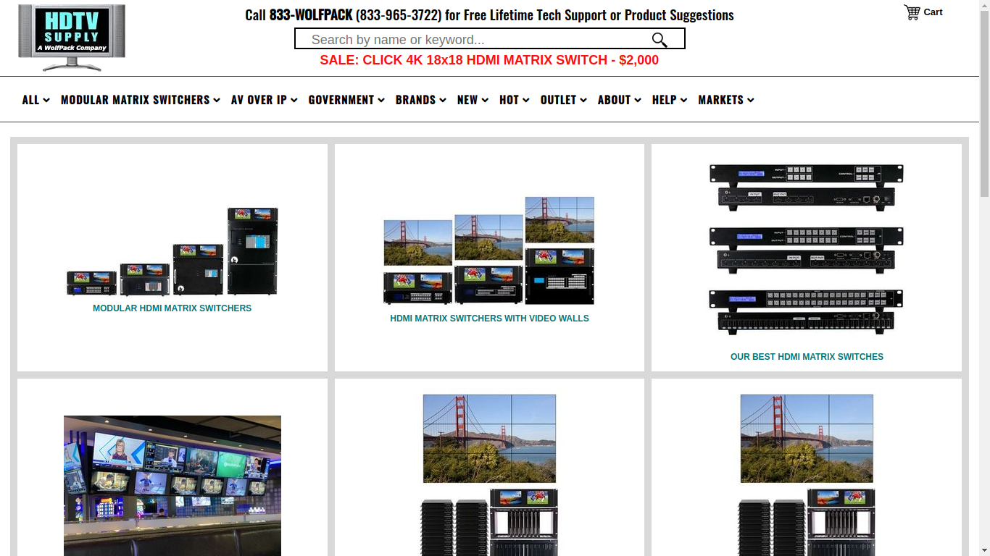
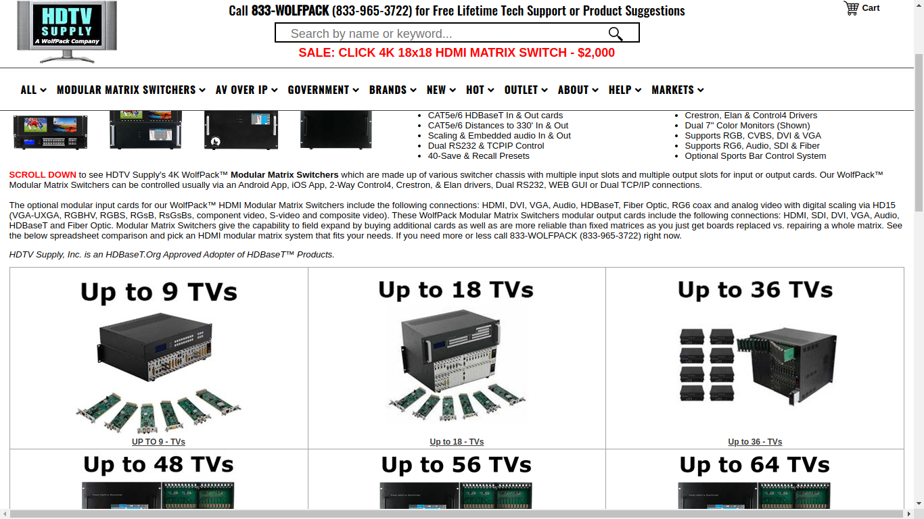
SEO Portfolio
https://www.hdtvsupply.com/
Products & Category Page

Slide 15
Voice Search Services

Slide 16
SEO Copywriting Services

Slide 17
Blog Copywriting
Blog Samyakonline.net
Expecting a much better ROI on email marketing is very common. Unsatisfactory gains of email sending often drive digital marketers to intense their efforts further for sending more numbers of emails or buying more email lists at a higher cost. Do these conventional practices to get more leads and revenue through email marketing click? The more numbers of emails sent for marketing don’t guarantee for a better return because ‘email deliverability’ plays an important role behind the curtain.
More>>

Slide 18
Article Copywriting
Article KrSchool.com
Parents today are focused on what they can offer their kids in terms of better health, security and career. Hence, most parents today are serious about the schools that they choose for their kids. Education has become one of the necessary things that parents need to think about apart from food, clothing and shelter. Hence, when you want your child to have the best education you need to focus on choosing the best schools locally. If you live in Delhi, you need to start looking for the best schools in Delhi.
More>>

Slide 19
PR Copywriting
PR CastleGarageDoors.com
Castle Improvements is a family-owned company in business since 1981. It has been consistently fulfilling all garage door product and service requirements of people in San Diego. Therefore, the majority of people seeking quality brands and top-notch service prefer to count on Castle Improvements. Whether people count on this leading enterprise for residential, commercial, and industrial overhead door products and services for the first time or are repeat customers, they always get rewarding experiences in the end.
More>>

Slide 20
PPT Copywriting
PPT PolyPak.au.com
The choice of material is an important factor when it comes to your packaging design. You need to choose the material as per your brand style and customer preference. Around 68% of consumers nowadays prefer cardboard packaging bags to plastic. So, you may consider that for your products.However, always choose high-quality material to ensure that there’s no wear and tear during transportation. Such a situation gives a bad impression to customers about your services and products.
More>>

Slide 21
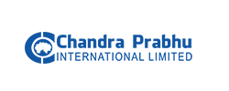
Clientele

Slide 22
Samyak Online Services Pvt. Ltd. M-4, Samrat Bhawan, Ranjit Nagar Commercial Complex, New Delhi - 110008, INDIA Phone: +91-11-49869226 Cell: +91-9810083308 [Nearest Metro Station: Shadipur] Email: inquiry@samyakonline.net Website: https://www.samyakonline.net
Follow us on Social

